Slide 1
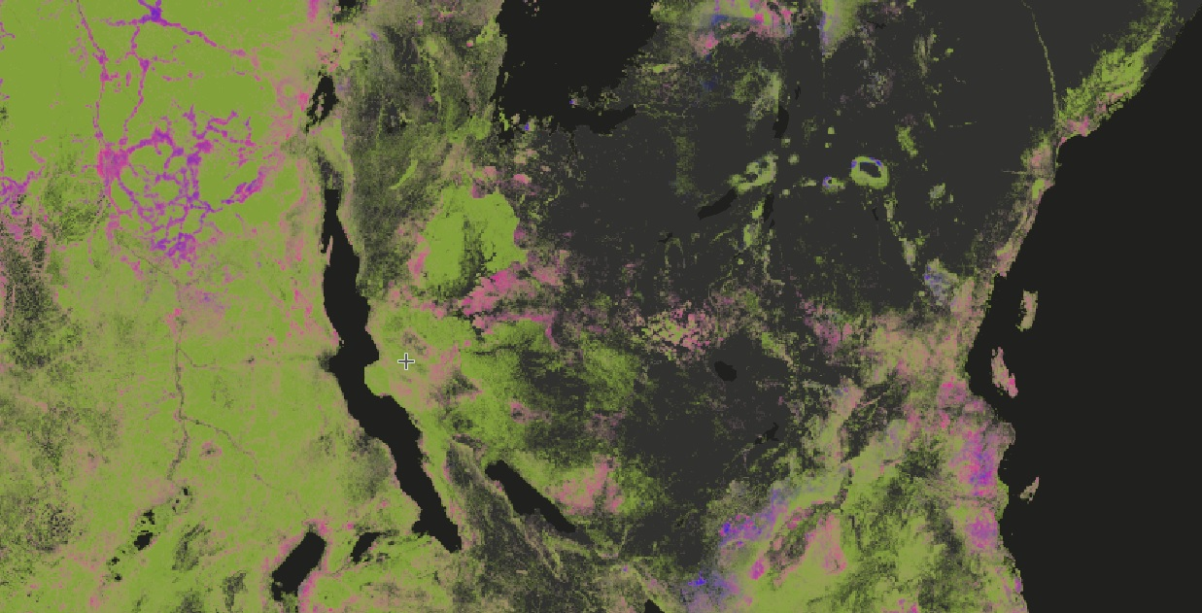
Com-Dev Community of Practice GIS Tutorial
By Seth Morgan
10/21/2022

Slide 2
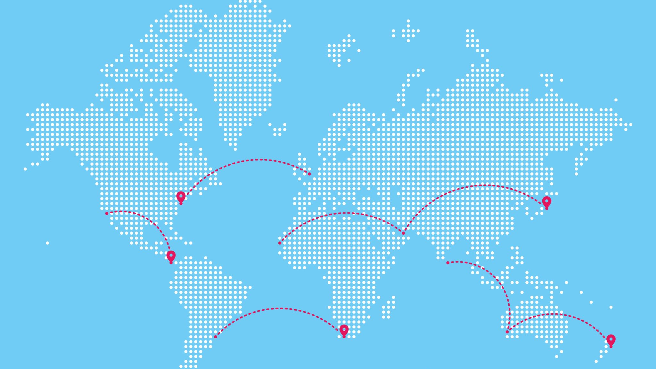
What is GIS?
Geographic Information System
Basically: maps connected to data

Slide 3

Questions you can answer with GIS
Are high-poverty regions in my state all next to each other, or scattered across the state?
How many people in my city live within 5 miles of a grocery store?
What is the relationship between pollution and housing costs?
Where are the population centers in my country vs. the areas with the highest rainfall?
Which villages in my country are most similar to mine in terms of tree cover, population, and distance to urban areas?

Slide 4
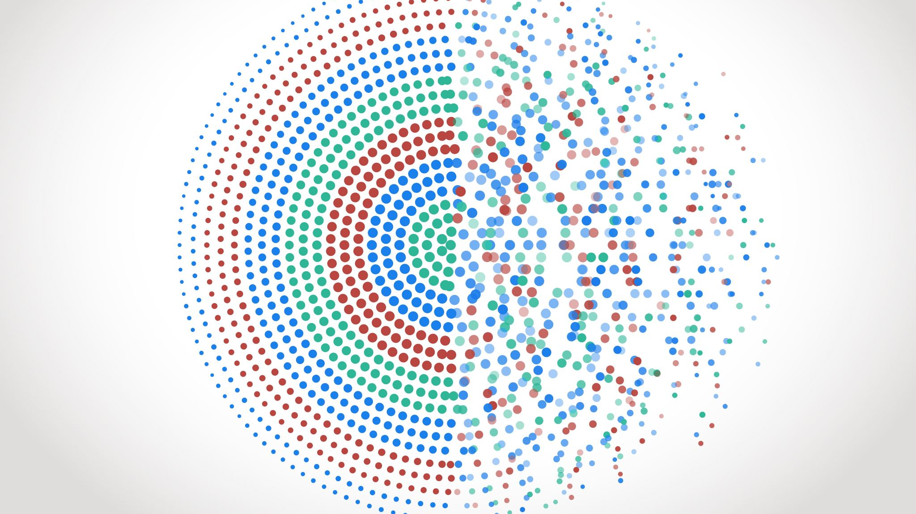
Types of Spatial Data
Vector: Represents places
Points
Lines
Polygons
Raster: Represents data values
Gridded pixels

Slide 5
Sources of Spatial Data
GADM.org (worldwide administrative boundaries)
TIGER shapefiles (US Counties and census blocks)
Earth Explorer (US government raster data)
Google Earth Engine (lots of stuff)

Slide 6
Key Terms
Coordinate Reference System (CRS)
The system used to display globe-shaped data on a flat computer-screen grid
Can be either Geographic (preserving the globe-shape behind the scenes) or Projected (actually transformed to flat).
Most common is WGS84 (Geographic)
Projection
The method used to turn globe-shaped data into flat data.
Common projections include Universal Transverse Mercator, and Lambert Equal Area.
Attribute Table
The spreadsheet connected to your spatial data
Chloropleth
A map made by coloring the map elements based on the value of one column in the attribute table

Slide 7
Additional Resources
QGIS Documentation
QGIS Tutorials
Google Earth Engine tutorials

